Slide 1
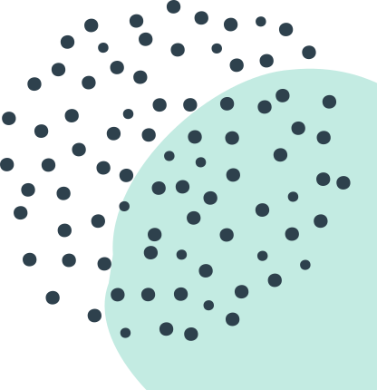
SHIPPENSBURG
UNIVERSITY PSYCHOLOGY DEPARTMENT
Clinical Psych Conversations:
Coping During Covid-19
Dr. Norwood & Dr. Weikel
9.29.2020
Notes:
introductions

Slide 2
Today's Workshop
DISCUSSION TOPICS
Impact of COVID-19 on Wellbeing
What is coping? Can I do it better?
Biopsychosocial Framework for Understanding Stress and Coping
Individual Nature of Coping
Improving Coping during COVID

Slide 3
Overview: COVID & College
MENTAL HEALTH
The pandemic has led to increased stress, loneliness, anxiety, and depression among college students.
COPING SKILLS
Everyone has unique coping skills, some adaptive and some maladaptive, that they use to deal with stress.
OVERALL WELLNESS
Working on positive coping skills can help college students deal with the uncertainty of the pandemic and maintain their overall wellbeing.

Slide 4
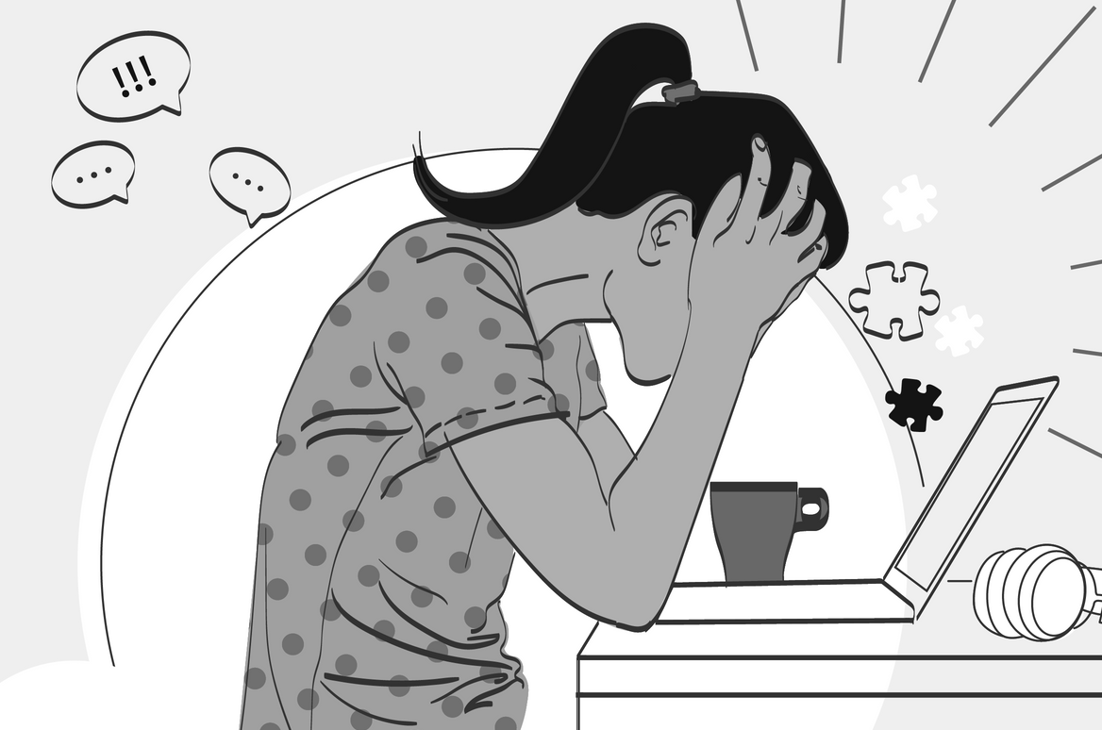
COVID Distress
Might Look Like:
Increased anxiety and uncertainty
Feelings of loneliness or sadness
Feelings of helplessness and frustration
Changes in eating or sleeping patterns
Changes in substance use
Information/update burnout
Exacerbation of existing mental health concerns
What have you noticed?

Slide 5
What is coping?
The ways in which we respond to or manage stress/uncomfortable emotions – the ways in which we respond to life’s demands.
Examples?
Is coping always positive or adaptive?

Slide 6
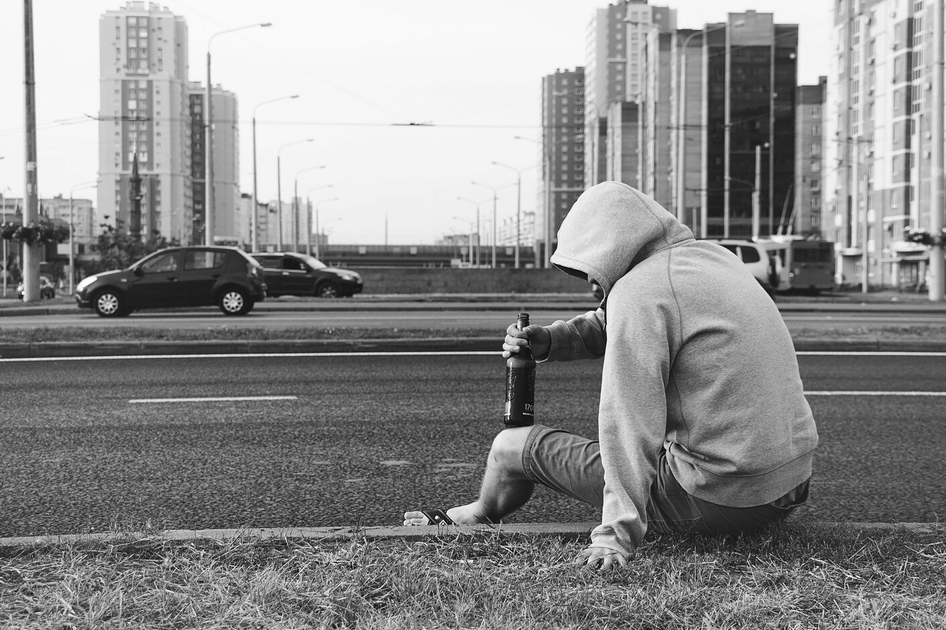
MALADAPTIVE COPING
ADAPTIVE COPING

Slide 7
Avoidance of underlying concerns
Prolonged distress
Short-term gain, longer-term pain
Worsening of initial symptoms
Consequences of Not Coping Effectively

Slide 8
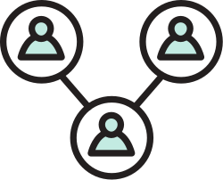
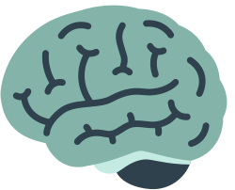
Biopsychosocial Framework
The biopsychosocial model considers biological, psychological, and social factors and their complex interactions in understanding health and our experiences as humans. All of these elements influence our wellbeing.

Slide 9
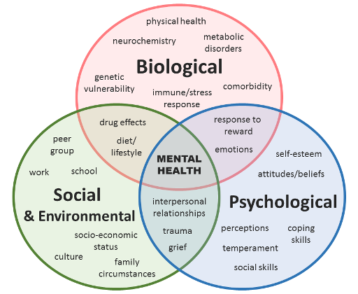
Biopsychosocial Framework

Slide 10
Individual Nature of Coping
One size doesn’t fit all… we can’t hand out a comprehensive coping manual and tell everyone to have at it.

Slide 11
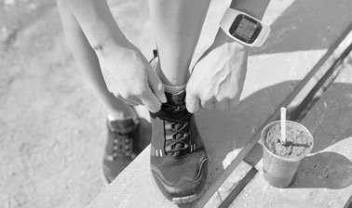
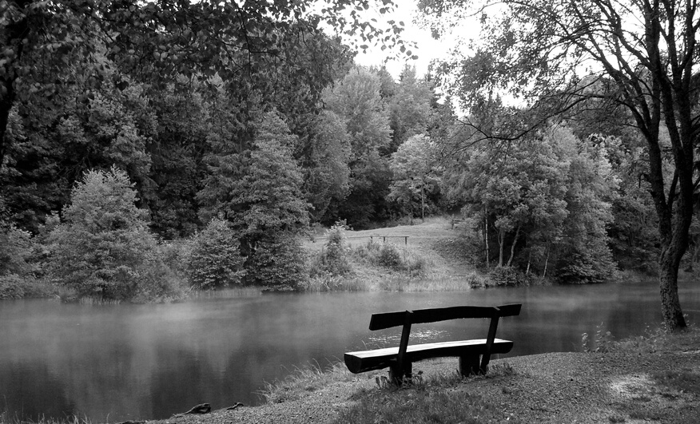
A few tips..
(but consider what works for you!)
TAKE CARE OF YOUR PHYSICAL HEALTH
MAINTAIN SOCIAL CONNECTIONS
TAKE A BREAK

Slide 12
KEEP A ROUTINE
A few tips..
(but consider what works for you!)
SPEND TIME OUTSIDE
REACH OUT FOR HELP

Slide 13
Questions/
Discussion

Slide 14
Shippensburg Counseling Center
Shippensburg Health & Wellness
CDC Webpage on Coping with Pandemic Stress
Personal Wellness Self-Screening Quiz
Wellbeing Planning Tool
Self-Help Guides on Different Topics
Video Clips on Wellbeing during COVID
Emotional Wellbeing and Coping During COVID-19
What's Up? - A Mental Health App
Stop, Breathe, Think - A Mindfulness App
Helpful Links & Resources

Slide 15
Crisis Resources
National Suicide Prevention Lifeline: Call 1-800-273-TALK (8255)
Crisis Text Line: Text “START” to 741-741
Shippensburg Webpage of Crisis Helplines & Resources

