Slide 1

What changes have you led in your workplace?

Slide 2
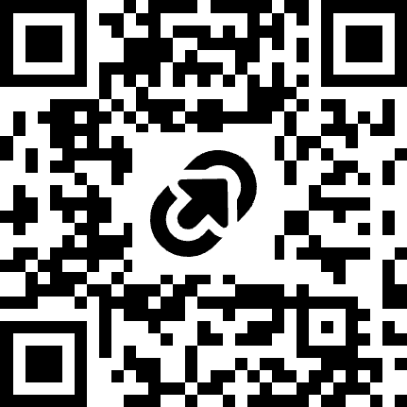
Leading Organizational Change
Dr. Wendy Kubasko / Fall 2026
https://tinyurl.com/y2fdfthw

Slide 3
Learning Objectives
Participants will
evaluate change management strategies.
leverage their role in organizational transformation.
develop an action plan for leading change initiatives effectively within their workplace.

Slide 4

Reflecting on a Recent Change
Consider a recent change you led or supported…
What actions were effective and you would choose to do again?
What actions would you
change, tweak, or add?

Slide 5
What is Change Management?
Harvard Division of Continuing Education defines change management as:
A planned methodology that enables leaders to successfully guide an organization through change, while minimizing disruption and the risk of unexpected consequences.
https://professional.dce.harvard.edu/blog/7-reasons-why-change-management-strategies-fail-and-how-to-avoid-them/#What-is-Change-Management-and-Why-Do-We-Need-It

Slide 6
7 Change Management Pitfalls
Incomplete or Poorly Defined Change Strategy
Following a Strategy Rigidly or Inflexibly
Lack of Effective Communications
Failing to Identify and Address Resistance
Disconnect Between Strategy and Culture
Setting Unrealistic Expectations
Not Creating and/or Celebrating Small Wins
https://professional.dce.harvard.edu/blog/7-reasons-why-change-management-strategies-fail-and-how-to-avoid-them/#What-is-Change-Management-and-Why-Do-We-Need-It

Slide 7
Define a Change Strategy

Slide 8
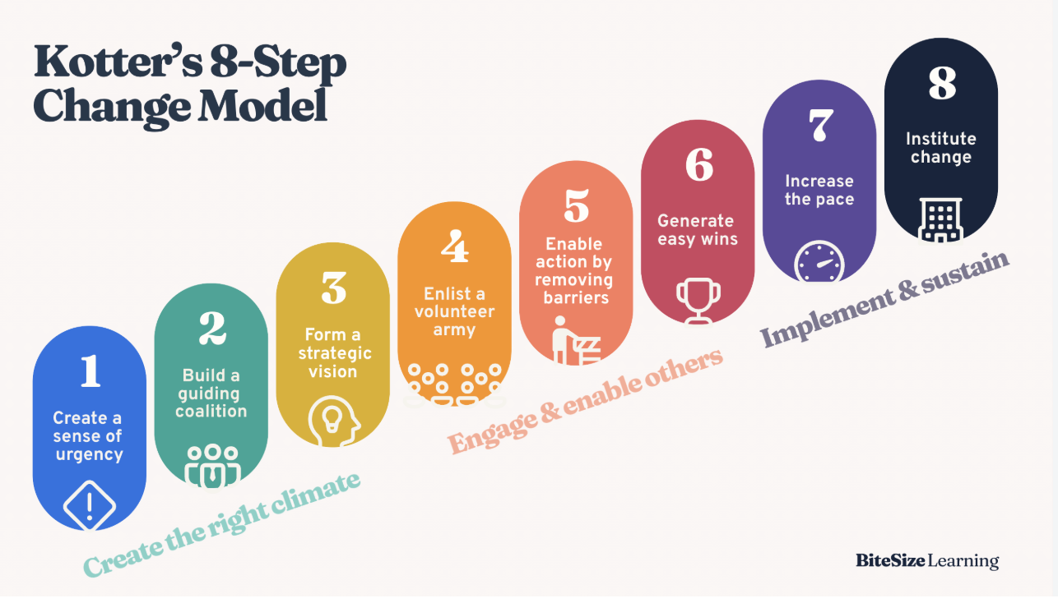
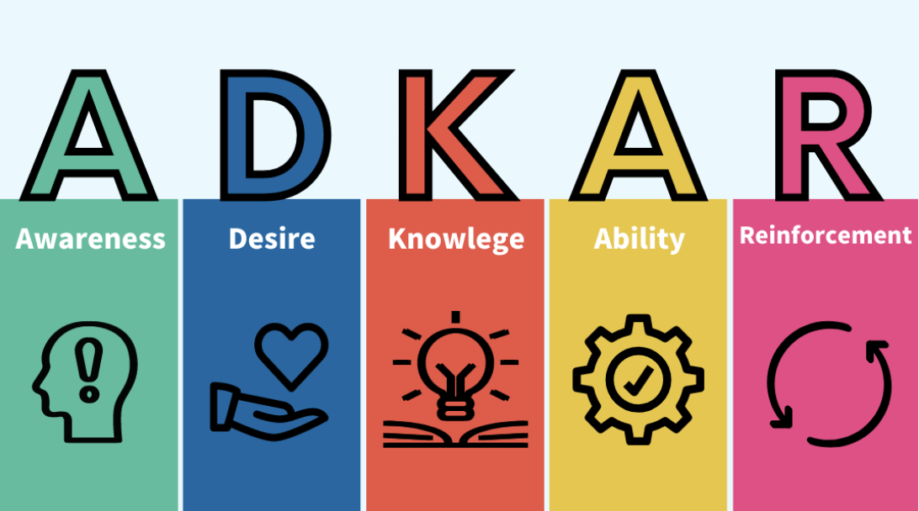
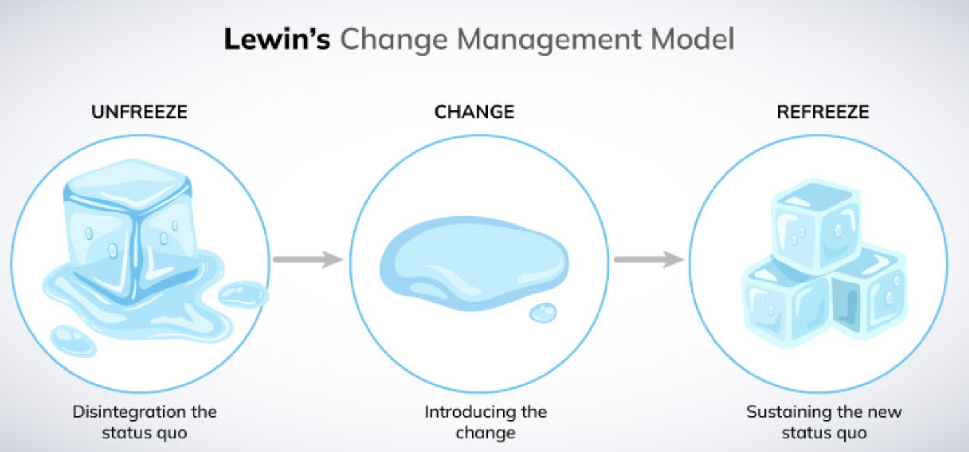
Change Strategies

Slide 9
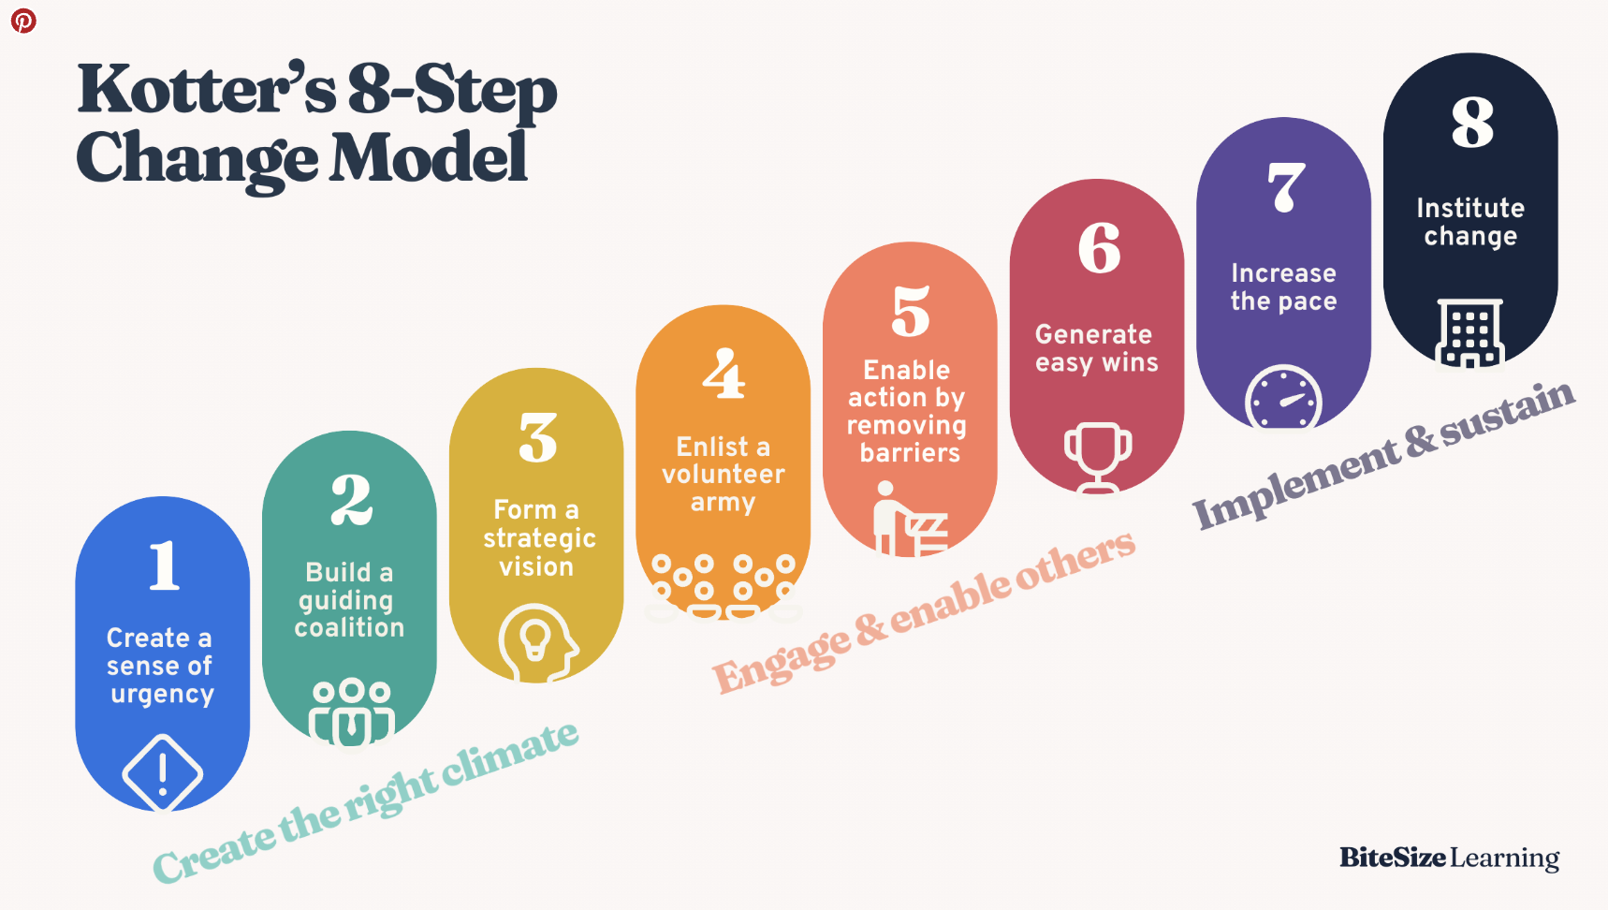
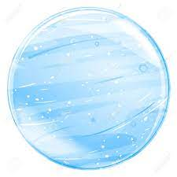



Slide 10
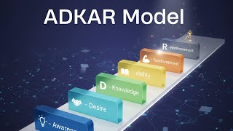

Slide 11
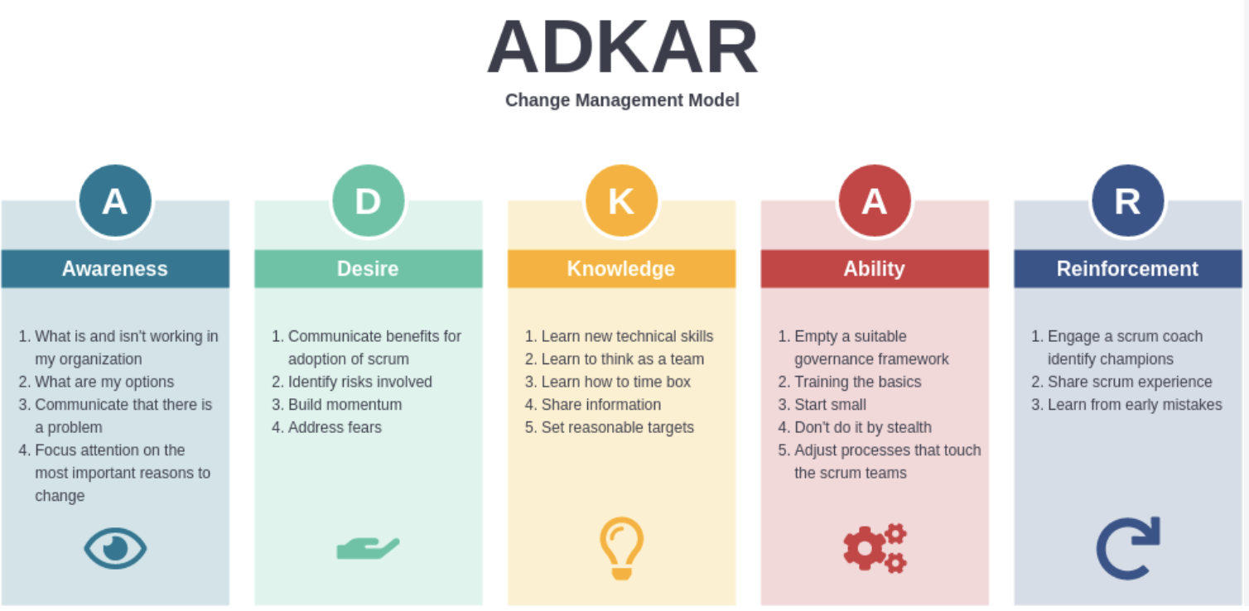
Prosci’s ADKAR

Slide 12

Consider your current organization…
What change strategy will work best for your culture?
What change strategy best fits
your team?
your leadership style?

Slide 13
Revisit and Revise the Change Plan Regularly

Slide 14
Deming’s Circle
Act
Plan
Check
Do
Notes:
Known as the Deming Circle - PDSA - study -- 1950’s -- quality assurance
Walter A, Shewhart, mentor of Demings (originator) 1920’s

Slide 15

Time to Reflect
How do you plan to gather feedback on changes in your organization?
How does your team know that you used their input in revising the change plan?

Slide 16
Dealing with Resistance

Slide 17
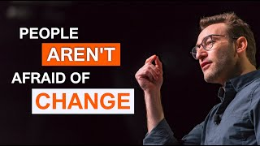

Slide 18

Quick Poll
Are you familiar with The Change Curve?
If so, does the content inform the way your manage change in your organization?

Slide 19
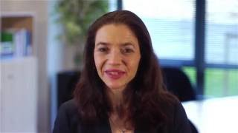

Slide 20
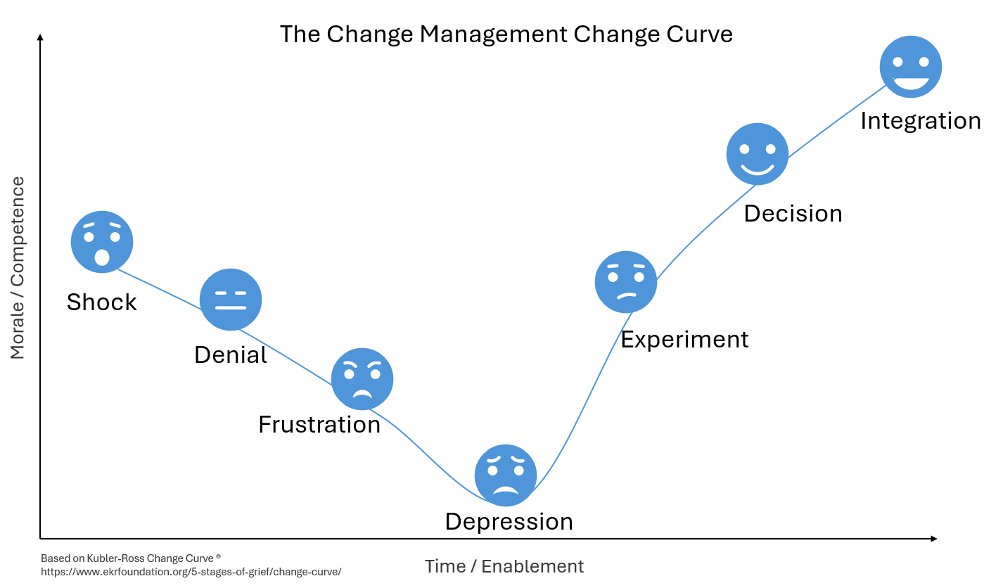

Slide 21
Communicating & Coaching

Slide 22

Communicate, Communicate, Communicate…
Is there a clear understanding of the WHY?
Why change?
Who benefits?
Why me?
Are there steps laid out to support the HOW?
When will it happen?
What resources?
What training?
What are the expectations?

Slide 23
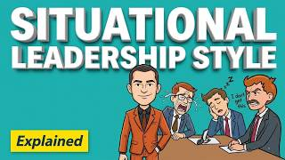

Slide 24
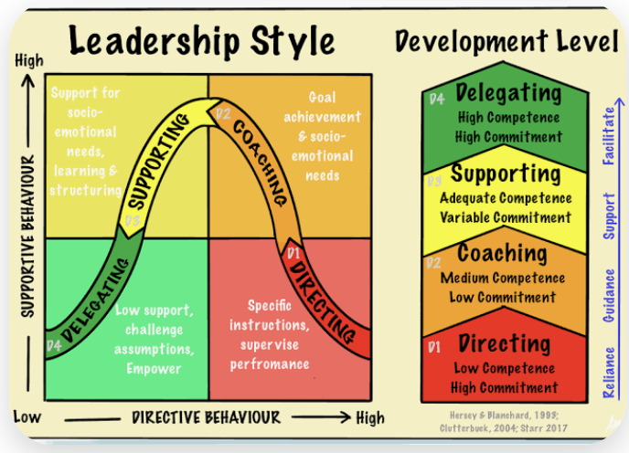

Slide 25
Consider your actions…
Are you a situational leader?
Which style do you use most often?
  Delegating
  Supporting
  Coaching
  Directing

Slide 26
Goal Setting

Slide 27
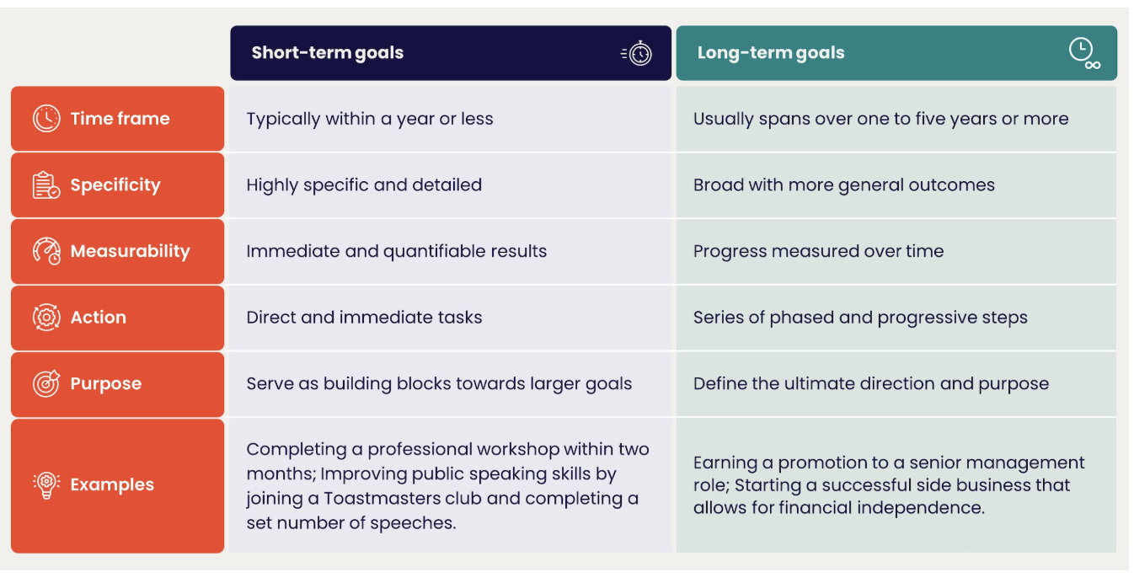
Short and Long Term Goal Setting

Slide 28
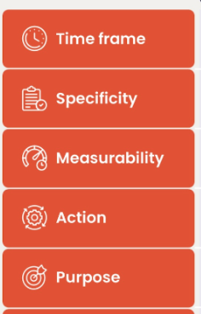
Reflecting on Your Goals
Considering each of the categories on the left, brainstorm your short and long term goals related to the change you identified.
Notes:
if time, share out a few options.

Slide 29
Celebrating Wins

Slide 30
Recognition is a psychological need. People need to feel that their work and contributions are appreciated, as this can help them improve their performance and feel more connected to the workplace. Reflecting on your team’s achievement is crucial for employees’ morale.
https://www.workhuman.com/blog/how-to-celebrate-success-at-work/

Slide 31
Recognition with Intention
From the department or team perspective, consider what accomplishments align with your team’s shared goals or values. Celebrating achievements tied to these priorities reinforces their significance.
Specific. Highlight how someone’s efforts helped solve a pressing issue or supported the team during a challenging time.
Timely. Delayed acknowledgments lose their power, so managers should act quickly to ensure celebrations feel timely and relevant.
Tailored. Recognition is only effective if it resonates with those being recognized. Ideally, it connects with the values and motivations of a person who is being recognized and also their preferences.
https://hr.umn.edu/supervising/news/Small-Wins-Big-Impact-Recognizing-and-Celebrating-Progress-Work

Slide 32
Time to Reflect
How do you intentionally recognize
your team members?
How do you encourage team members to recognize each other?

Slide 33
Time to Plan
Use the notetaker (p. 13) to create a plan
for your change.
Complete the sections that matter most to you.

Slide 34
Final Reflection
What is the one action you are
most committed to taking?

Slide 35
Leading Organizational Change Resources
https://professional.dce.harvard.edu/blog/7-reasons-why-change-management-strategies-fail-and-how-to-avoid-them/#What-is-Change-Management-and-Why-Do-We-Need-It.
https://degree.astate.edu/online-programs/undergraduate/organizational-leadership/baol/change-management-strategies-guide/
https://hr.berkeley.edu/sites/default/files/change_management_toolkit.pdf
https://www.youtube.com/watch?v=vR1af-Q7Z7U
https://www.youtube.com/watch?v=J88aaHWXeaM
https://online.hbs.edu/blog/post/change-management-process
https://www.prosci.com/methodology/adkar
https://situational.com/situational-leadership/
https://hr.umn.edu/supervising/news/Small-Wins-Big-Impact-Recognizing-and-Celebrating-Progress-Work
https://www.workhuman.com/blog/how-to-celebrate-success-at-work/
https://youtu.be/J88aaHWXeaM?si=-64q65EeOhjcRmJH

Slide 36
Contact Information
Dr. Wendy Kubasko
wlkubasko@ship.edu

