Slide 1


Communication & Intentional Listening
Dr. Wendy Kubasko
Shippensburg University
July 2026
Notes:
Open Mentimeter first

Slide 2

www.menti.com
Code: 1522 4975
Why is Listening So Hard

Slide 3
By the numbers
125 Words Per Min
400 Words Per MIn
50% of What We Hear
Notes:
25% of our brain is activated as we listen - leaving 75% to do what it wants!

Slide 4


Slide 5
Session Objectives
Describe strategies for active listening skills.
Identify the benefits of active listening skills and how they can support customer service.
Practice active empathetic listening skills using customer service scenarios.

Slide 6
Types of Listening
Task-Oriented
Analytical
Critical
Relational

Slide 7
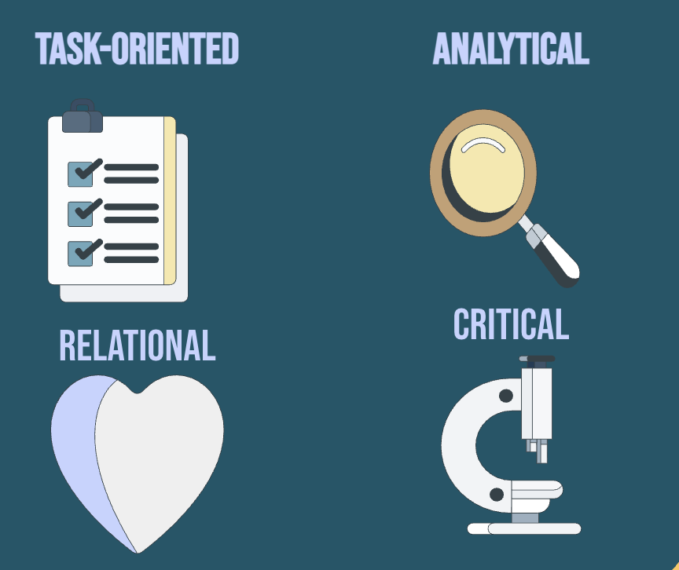
Breakout Groups
What types of listening do you use most often?
What do you struggle with as a listener?
Notes:
5 min

Slide 8

Group Share

Slide 9
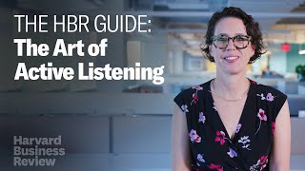

Slide 10
Active vs. Passive Listening
Active
Neutral and nonjudgmental
Patient (periods of silence)
Verbal and nonverbal feedback
Asking what am I missing?
Reflecting back what is said
Non-competitive
Passive
Fairly one-sided communication
Little to no feedback
Requires very little effort
Can miss parts of the conversation
Not fully paying attention
Little indication that he or she is listening

Slide 11
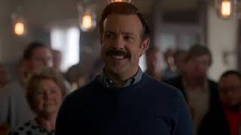
Be curious … not judgemental.

Slide 12
"When someone says, 'Can I talk to you?' I immediately think..."
www.menti.com
Code: 1522 4975

Slide 13


Benefits of Listening
Improves …
  Problem solving skills
  Relationships
Increases
  Empathy
  Creativity
  Productivity
  Self-Awareness
Encourages
  Brainstorming & Collaboration
  Better Brain Function

Slide 14

Work
Teamwork
Decision Making
Customer Service
Sales
Negotiation
Leadership

Slide 15

“Listening...involves a certain surrender,
a willingness to sit with what one does not already know…it requires us to stretch a little beyond what we know, expect or want.”
Diana Senechal

Slide 16
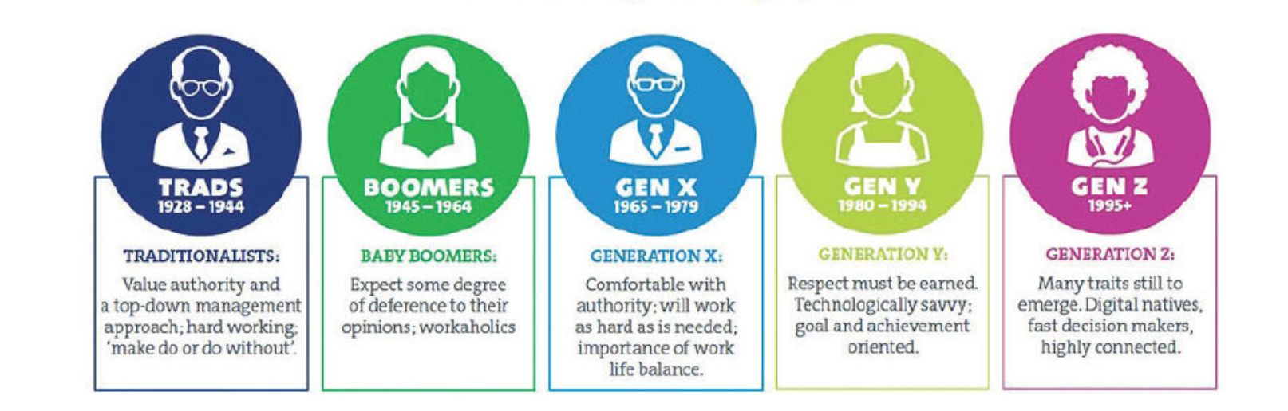
By the Generations
https://www.monitordaily.com/article-posts/next-generation-customer-service-serving-clients-want-served/

Slide 17

Traditionalists
Don’t rush things and keep your interaction to a relaxed pace
Establish rapport by being respectful in an old-fashioned way. Don’t forget to watch your language
Be a bit more formal, leaving a respectful distance between yourself and your customer.
* Remember to avoid being too chummy or over-personal
https://skillpath.com/blog/quick-customer-service-tips-for-pleasing-different-generations

Slide 18

Boomers
Be personable, especially in your greeting. If you know their name, use it when you greet them
Take time to check in and find out how they’re doing
Treat them like friends
If they are regular customers, give them something extra to ensure continued patronage—such as, throw in that extended warranty with their purchase for free
https://skillpath.com/blog/quick-customer-service-tips-for-pleasing-different-generations

Slide 19

Gen X
Be efficient. Competence matters more to Xers than schmoozing
Make yourself available to share information. Xers tend to be cynical and distrusting of marketing and appreciate customer service reps that offer information
Don’t hover. Give the customer a little more room and allow Xers to make their own decisions
Don’t be put off by Xers’ aloofness. Most won’t be warm and friendly to you
https://skillpath.com/blog/quick-customer-service-tips-for-pleasing-different-generations

Slide 20

Gen Y - Millenials
Be respectful—don’t talk down or condescend to them just because they’re young
Be sensitive to the generational clash between Boomers, Xers, and Millennials
You don’t have to do a song and dance but pick up the pace and look lively
Value personalization over speed, so try to skip the AI experience as much as possible and get them to a human
https://skillpath.com/blog/quick-customer-service-tips-for-pleasing-different-generations

Slide 21

Gen Z
Faster is better for Gen Z In fact, they even talk faster than any other group. The 18-to-24-year-old age group is 60% more likely than the average consumer to hang up if a business doesn’t answer the phone right away—four rings or fewer
Gen Z will leave a brand entirely after only three bad customer service experiences
On the other hand, a great customer experience is nearly guaranteed to get your praises sung on Instagram or Twitter
Unlike Millennials, Gen Z are actually more apt to make phone calls. In fact, this age group is the most likely of any demographic to click-to-call a business from a cell phone after searching for the business online.
https://skillpath.com/blog/quick-customer-service-tips-for-pleasing-different-generations
Notes:
Break

Slide 22
Breakout Groups
What do you notice about
your interactions with
different generations?
Notes:
Break right after this (45 min mark)

Slide 23
Active Empathetic Listening

Slide 24
Difficult Conversations - Dealing with Conflict
Many people avoid conflict.
Avoidance can lead to poor communication and misunderstanding.
It is natural (and part of the human neurological system) to respond to conflict in specific ways.
Active - Empathetic Listening is the first step to gaining information about the individual’s needs, values, interests and goals.

Slide 25
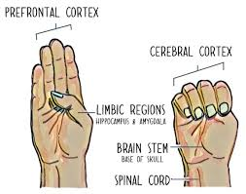
Brain Hand Model

Slide 26
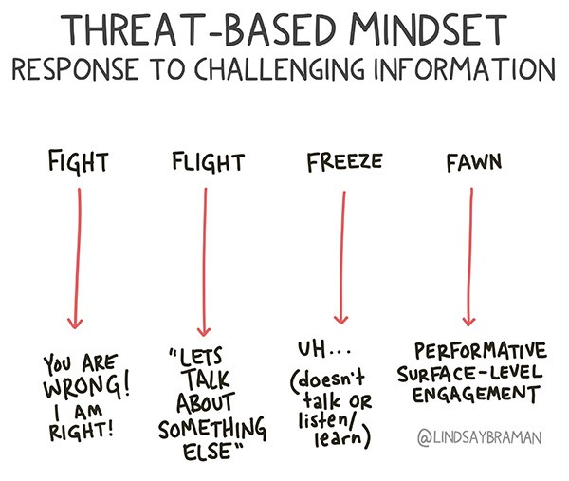

Slide 27

Active-Empathetic Listening
Use non-verbal involvement.
Pay attention to the speaker, not your own thoughts.
Practice Non-Judgment.
Tolerate silence.
Paraphrase.
Ask questions.

Slide 28

Limbic Resonance

Slide 29
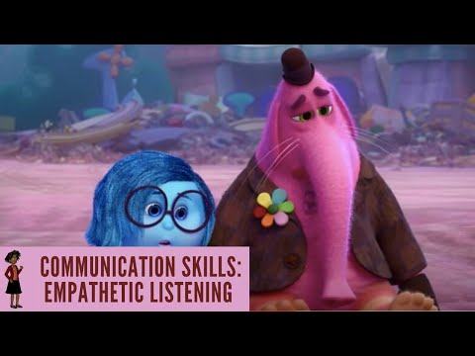

Slide 30
Mirroring to De-esclate
When a Customer is Upset
Mirroring Techniques
Remember they may be in flight, fight, freeze, or fawn mode.
They may not be thinking clearly.
Drop your shoulders, take a deep breath, slowly breathe out to release tension.
Lower your voice. Speak calmly and quietly.

Slide 31
Customer: "I don't understand why you need all this information just to open an account. I've banked here for years."
What would you say next?
www.menti.com
Code: 1522 4975

Slide 32


The Power of Pause
Silence opens the space for more conversation.
Silence leads to engagement.
Silent listening requires us to slow down.

Slide 33
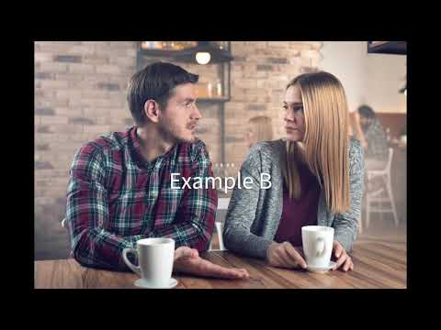
Notes:
Chat Waterfall
(Yes - interruption, No - not interruption - bonus points for why)

Slide 34
Active-Empathetic Listening
Use non-verbal involvement.
Pay attention to the speaker, not your own thoughts.
Practice Non-Judgment.
Tolerate silence.
Paraphrase.
Ask questions.

Slide 35
Breakout Groups - Practice Time
Scenario:
"I've been waiting for three days to get this fixed. This is ridiculous!"
Decide on Roles (Customer, Rep, Observer).
2. Use Active Empathetic Listening Strategies.
3. Observer Gives Feedback.

Slide 36
What is one intention you plan to put in place this week?

Slide 37



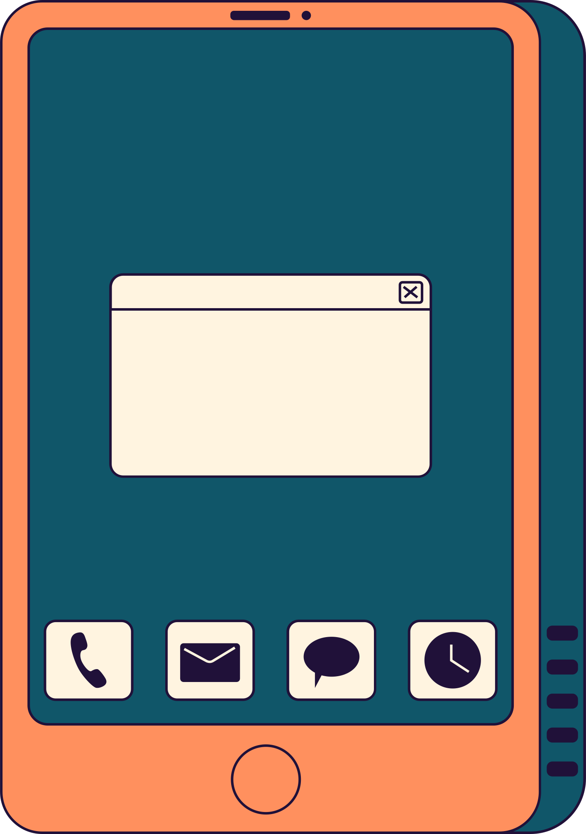




Thank you!
Dr. Wendy Kubasko
717-477-1765
wlkubasko@ship.edu

Slide 38


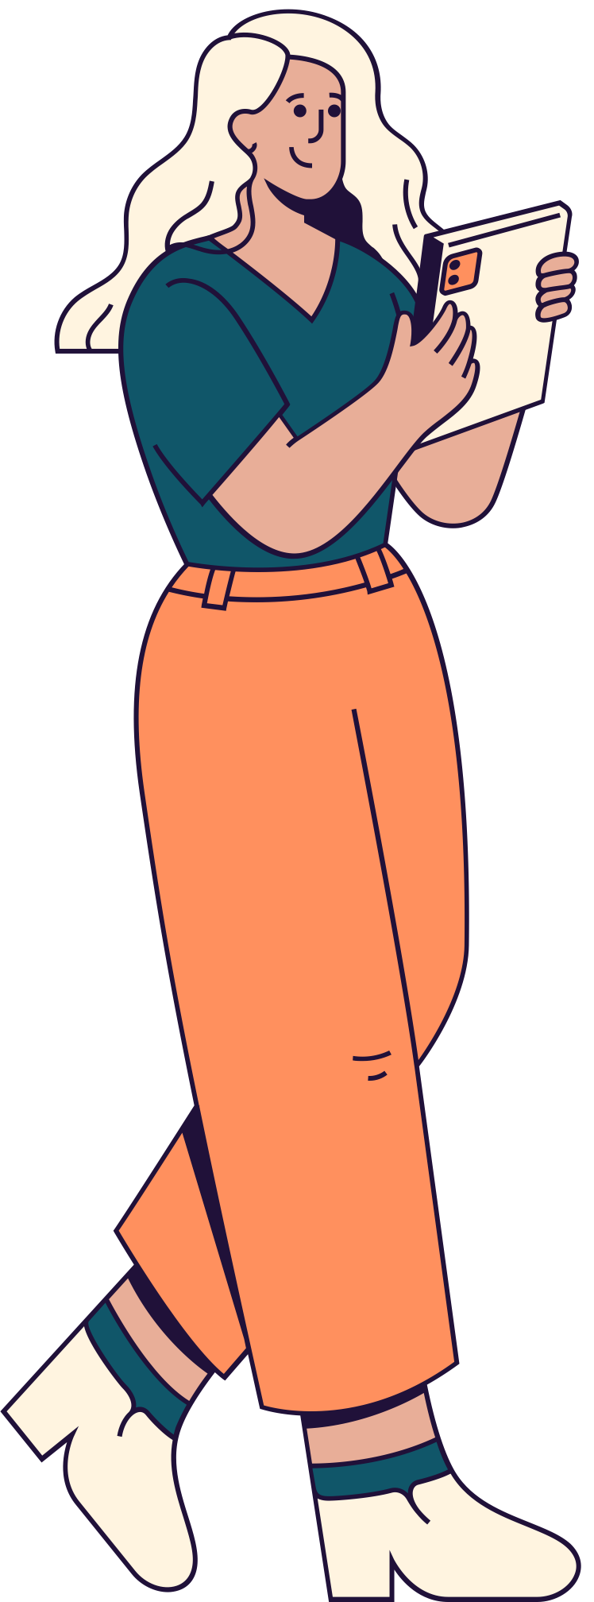


Credits
This presentation template is free for everyone to use thanks to the following:
SlidesCarnival for the presentation template
Pexels for the photos
Happy designing!

